Slide 1

ORMs, Micro ORMs, and MS SQL Adapters in .NET
Adapters, Dapper, and Entity Framework
Vanyo Vanev
Development Team Manager
04.10.2023

Slide 2


AGENDA
- Introduction
- Adapters
- Dapper (Micro ORM - Object-Relational Mapper)
- Entity Framework (ORM)
- Comparing Adapters, Dapper, and Entity Framework
- Q&A and Conclusion

Slide 3
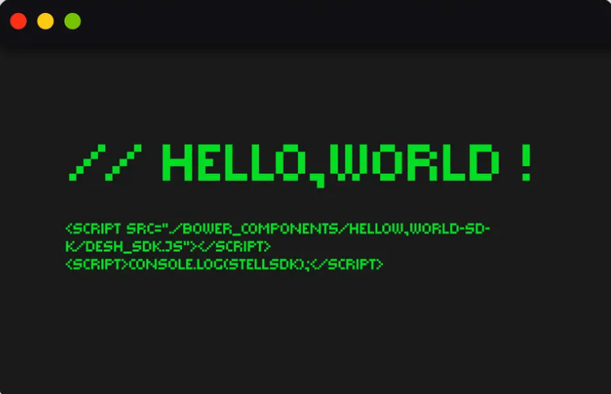
INTRODUCTION
- The importance of database interaction in
backend development
- Efficient and secure data storage and retrieval
- Backend services often depend on data from databases
- Essential for creating scalable and maintainable
applications

Slide 4

OVERVIEW
1. Adapters
- Provide low-level access to databases
- Part of ADO.NET framework
2. Dapper (Micro ORM)
- Lightweight, high-performance library
- Simplifies working with databases compared to Adapters
3. Entity Framework (ORM)
- Comprehensive object-relational mapping framework
- Supports advanced features and automation

Slide 5

OBJECTIVES
- Understand the differences between Adapters,
Dapper, and Entity Framework
- Learn how to use each tool for basic
CRUD operations
- Gain insights into the pros and cons of each tool
- Determine the best tool for your specific
needs and preferences

Slide 6
ADO.NET Adapters
DEFINITION
PURPOSE IN .NET
Adapters are part of the ADO.NET framework, which provides a set of classes for working with data and databases.
ADO.NET, can trace their roots back to the early days of the .NET Framework, which was first released in 2002. ADO.NET is a successor to Microsoft's earlier data access technology called ActiveX Data Objects (ADO).
Adapters are components that facilitate communication between an application and a database.
ADO.NET was designed to be more in line with the .NET programming model, utilizing managed code and providing a consistent way to access various data sources.
ADO.NET.Csv Example

Slide 7
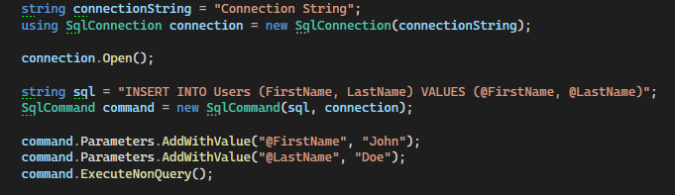
SQLCONNECTION, SQLCOMMAND
AND SQLDATAREADER
- SqlConnection: Establishes a connection to a SQL Server database.
- SqlCommand: Represents a SQL statement or stored procedure to execute against a SQL Server database.
- SqlDataReader: Provides a way of reading a forward-only stream of rows from a SQL Server database.
MSSQL Adapter Example

Slide 8

PROS & CONS
Pros:
- Low-level control over database interaction
- Lightweight and fast
Cons:
- More code needed for simple operations
- Prone to SQL injection if not used carefully
- Lack of abstraction makes it harder to switch between different databases

Slide 9
Dapper
DEFINITION
PURPOSE IN .NET
Dapper is a Micro ORM (Object-Relational Mapper) for .NET that simplifies data access.
Dapper was developed by Stack Exchange in 2011 as an alternative to heavier ORMs like Entity Framework. The goal was to create a high-performance, lightweight data access library that would simplify database interaction without sacrificing speed.
Dapper gained popularity in the .NET community due to its minimalistic approach and impressive performance.
Micro ORMs strike a balance between raw database access using adapters and the higher level of abstraction offered by full-fledged ORMs.

Slide 10
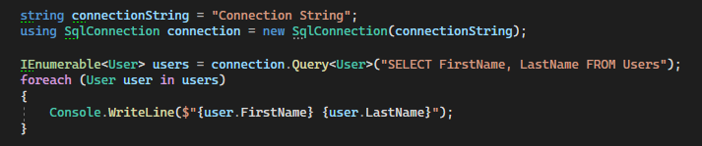
SQLCONNECTION, DIFFERENCES
WITH ADAPTERS
- SqlConnection: Establishes a connection to a SQL Server database.
- Gets rid of Commands by exposing direct methods for executing queries.
- Data is directly deserizalized into object
Dapper MSSQL Example

Slide 11
PROS & CONS
Pros:
- Lightweight and fast
- Reduced boilerplate code compared to adapters
- Easy to set up and use
Cons:
- Limited feature set compared to full-fledged ORMs
- Lacks some advanced features like change tracking and lazy loading
- Less abstraction than a full ORM

Slide 12
Entity Framework
DEFINITION
PURPOSE IN .NET
Entity Framework is a full-featured ORM for .NET that automates database-related tasks and provides advanced features.
Entity Framework (EF) was first released by Microsoft in 2008 as an ORM for .NET applications. It was designed to provide a higher level of abstraction when working with databases, making it easier for developers to interact with data in a more object-oriented manner.
Allows developers to create data models using C# classes and have the database schema generated automatically. The opposite is also true, data model can be generated from existing database.
Entity Framework integrates seamlessly with LINQ (Language Integrated Query), allowing developers to write type-safe, expressive queries using C# syntax, which are then translated into SQL and executed against the database.

Slide 13
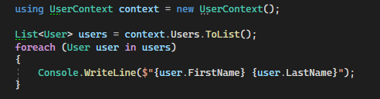
ENTITY FRAMEWORK ROOT OBJECTS
AND BASICS
- DBContext: the central object in Entity Framework that manages the database connection, tracks changes to entities, and coordinates database operations such as querying and saving data.
- DbSet<>: generic class that represents a collection of entities of a specific type. It acts as a gateway between the application's data model and the database, allowing developers to perform CRUD operations, as well as query the database using LINQ expressions.
Entity Framework MSSQL Example

Slide 14
ADVANCED FEATURES OF
ENTITY FRAMEWORK
LINQ:
Use LINQ queries to perform complex data operations without writing raw SQL.
Lazy Loading/Eager Loading:
Load related entities on demand, improving performance and reducing memory usage.
Migrations:
Manage and apply changes to your database schema over time.

Slide 15
PROS & CONS
Pros:
- High level of abstraction and convenience
- Rich feature set
- Support for advanced features like change tracking, lazy loading, and migrations
Cons:
- Slower performance compared to Dapper and traditional adapters
- Steeper learning curve
- More complex setup and configuration

Slide 16
Comparison
PERFORMANCE
EASE OF USE
WHICH ONE TO PICK
Adapters: Fastest, but more code needed for simple operations
Dapper: High-performance, lightweight library, ideal for performance-sensitive applications
Entity Framework: Slower performance due to the rich feature set and abstractions, performance can be optimized with techniques like lazy/eager loading
Adapters: High flexibility, but require more code and effort for simple tasks
Dapper: Easy to set up and use, with reduced boilerplate code compared to adapters
Entity Framework: Easier to work with complex data models and relationships, but has a steeper learning curve
Adapters: Ideal for low-level control and simple applications
Dapper: Great for performance-sensitive applications and streamlined data access
Entity Framework: Best suited for complex applications with rich data models and relationships

Slide 17

Q&A AND CONCLUSION
- Any questions?
- Concerns or clarify any points that may have been unclear during the presentation?

